Slide 1
AdWorks Agency New Employee Orientation
Advertising that is always on target.

Slide 2
Topics
About AdWorks
Accomplishments
Organization
Working with Clients
Health Insurance
Leave Time
Paperwork Process

Slide 3
Getting to Know the Company

Slide 4
About AdWorks
Full service marketing, advertising, and design firm serving regional & national clients
Started in 1989
Build & Position Brands
Print, TV, & Online

Slide 5
Accomplishments
2008 Cleo Award Winner Print: Direct Mail
Triangle Business of the Year (2007)
Local Disaster Relief Fund & Fight the Drought Awareness Ads
2007 Ad:Tich Award for Best Banner Ad & Best Next Generation Ad

Slide 6
Organization
Liz Doe, President
Bob Roberts, Sales Chief
Jim Francks, Head Salesperson
Beth White, Salesperson
Luiz Ramierez, Salesperson
Elizabeth Walter,
Design Specialist
Todd Ham, Designer
Tom Bridge, Head of Advertising
Katie Drew, Associate
Marcus James, Head of Accounting

Slide 7
Working with Clients
Satisfied Client
Sales
Design/Creative
Advertising
Media Relations
Main Content
Sells ad space
Contacts media outlets
Focus on layout and artistic elements
Know the target audience
Encompass a competitive edge

Slide 8
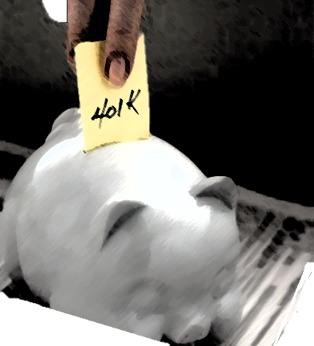
Understanding Your Benefits

Slide 9
Health Insurance
We provide comprehensive medical coverage for individuals and families.
Benefits start on the first day of employment.
Coverage includes Preferred Provider Organization (PPO)
Over 1,000 providers in the local area.
Health Incentive plans available for “Get Fit Now” program.

Slide 10
Leave Time
Paid Leave
Jury Duty
Disability
Organ Donor
Holidays
Funeral
Military
Sick
1 day per month
Vacation
12 days: 1-3 years
1 day extra per year
Unpaid Leave
Family and Medical Leave
Family Military Leave
School Activity
Non-approved Conference
Maternity

Slide 11
Paperwork Process
Supervisor provides paperwork to employee
Employee submits paperwork within one week
Tax Forms
401k
Emergency Contact Information

Slide 12
Resources
Free Online Computer Training: Great website for Microsoft Office classes, Computer Basics, and more.
Offline Resources: See your manager
Financial and Retirement Planning

