Slide 1
The Alaska Travel
Experience
The Alaska Travel Experience
Latitude: 54° 40' N to 71° 50' N Longitude: 130° W to 173° E
Karole McGrew

Slide 2
Statehood
August 1, 1868
Purchased from Russia for $7.2 Million ($.02 per acre)
Called “Seward’s Folly”
January 3, 1959
Became the 49th state of United States
Land mass larger than Texas, California and Montana combined.
Approximately 1/5th the size of all the other states together
Notes:
On March 30, 1867, the United States agreed to purchase Alaska from Russia for $7.2 million dollars, about two cents an acre; "Seward's Folly" many called it, after Secretary of State William H. Seward. A check for $7,200,000.00 was issued on August 1, 1868 and made payable to Edouard de Stoeckl, the Russian Minister to the United States.
On January 3, 1959, Alaska, with a land mass larger than Texas, California and Montana combined, became the 49th state in the union. It is a large state, 1/5 the size of all the other states together, reaching so far to the west that the International Date Line had to be bent to keep the state all in the same day. It's also the only U.S. state extending into the Eastern Hemisphere.

Slide 3
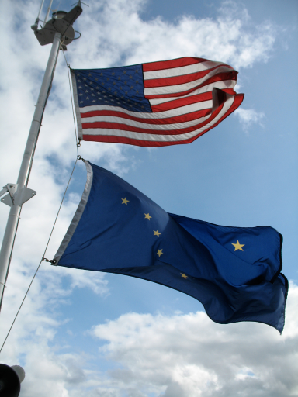
State Song
"Alaska's Flag" is the state song of Alaska.
Lyrics explains symbolism of flag

Slide 5
Ketchikan, Alaska
Sitka, Alaska
Juneau, Alaska
Anchorage, Alaska
Mount McKinley Ntl/ Park
Fairbanks, Alaska

Slide 6
Day 1 – Day 3
Start our exciting excursion at Ketchikan.
Southern most city in Alaska.
Ketchikan's economy is based upon tourism and fishing, and the city is known as the "Salmon Capital of the World”.
According to the United States Census Bureau, the city has a total area of 4.1 square miles (11 km²).
3.4 square miles (8.8 km²) of it is land
0.8 square miles (2.1 km²) of it (18.60%) is water.

Slide 7
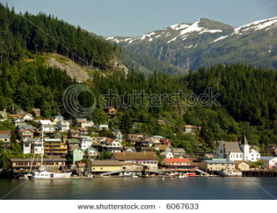
Ketchikan – Population: 8,050 Longitude/Latitude: 55.342 / -131.646
3 sq. miles of land and 1 sq. miles of water
Temperatures:
Summer temperatures range from 51 to 65
Winter temperatures range from 29 to 39
Ketchikan averages 162 in. (13.5 ft.) of precipitation annually (sometimes as much as 200 in.), including 32 in. of snowfall.
Ketchikan's name supposedly originates from the native term "Katch Kanna"
Roughly translates: "spread wings of a thundering eagle"
Rightly named, for you only need to look along the water line and you're likely to see many bald eagles on waterside perches.

Slide 8
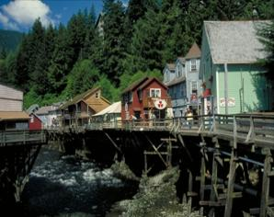
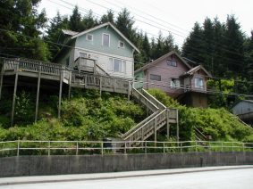
Ketchikan – Population: 8,050 Longitude/Latitude: 55.342 / -131.646
Backed by forested slopes & Deer Mountain
Faces the Tongass Narrows Waterway humming with floatplanes, fishing boats, ferries and barges hauling freight to other Inside Passage ports.
On one side of the Tongass Narrows many of the businesses and homes are built on stilts out over the water
While on the other side, they cling to the steep slopes and often have winding wooden staircases leading to their doors.

Slide 9
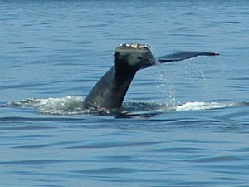
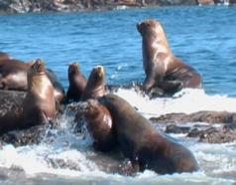
Ketchikan - Sea Lions and Whales Tour
West Rock
require 4 hours to view both sea lions and whales.
May and June,
Orca or "killer" whales frequents the Mountain Point area much closer to town.
Drawn here by the return of king salmon to a nearby hatchery.
Can grow to 27 feet long
Known to steal king salmon right off your hook even as you're about to bring it aboard your boat!

Slide 10
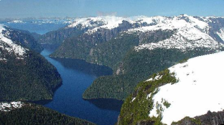
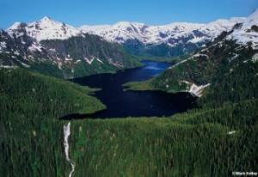
Misty Fiords National Monument
3,570-square-mile wilderness
Natural mosaic of sea cliffs, steep fjords and rock walls jutting 3,000 feet straight out of the ocean
Trips into the monument, whether by tour boat, flightseeing or kayak
result in wildlife sightings from seals and otters to bald eagles and whales.

Slide 11
Day 3 – Day 6
Day 3 ends with the departure from Ketchikan and the beginning of a 185 mile ferry trip to Sitka on the Alaska Marine Highway System.
Ferries serve communities in Southeastern Alaska that have no road access, and the vessels can transport people, freight, and vehicles.
The Ferry leaves Ketchikan at 5:45 p.m. and will arrive at Sitka the next after noon at approximately 5:30 p.m.

Slide 12
Ketchikan, Alaska
Sitka, Alaska
Juneau, Alaska
Anchorage, Alaska
Mount McKinley Ntl/ Park
Fairbanks, Alaska

Slide 13
Sitka – Population: 8,881 Longitude/Latitude: 57.053 / -135.33
Original Capital of Alaska
The only Inside Passage community that fronts the Pacific Ocean
Hugs Baranof Island's west shore
Mount Edgecumbe sits across Sitka Sound
A dormant volcano

Slide 14
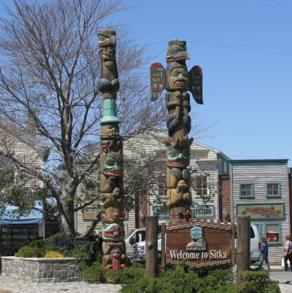
Native Culture
A vital part of Sitka's essence
Seen throughout town & on the trails in Sitka National Historical Park
Sheldon Jackson Museum
One of two official Alaska State Museums.
Represents many different Alaska Native cultures.
A remarkable collection of totem poles carved by Tlingit and Haida artists.

Slide 15
Day 7 – Day 9
Day 7 begins at an early hour. Our ferry leaves at 4:30 a.m. and makes a leisurely 92 mile trip to Juneau. The trip will finally make its entry into port at 4:45 p.m.
In using this ferry system, it allows the traveler to stop and stay in several ports along the way to their final destination or travel direct.
With a total of 32 ports throughout our Alaskan route the options are diverse.

Slide 16
Ketchikan, Alaska
Sitka, Alaska
Juneau, Alaska
Anchorage, Alaska
Mount McKinley Ntl/ Park
Fairbanks, Alaska

Slide 17
Juneau – Population 31,275 Longitude/Latitude: 58.302 / -134.42
Pivotal part of the Gold Rush of the late 1800s
Located in the Panhandle of Southeast Alaska
900 air miles north of Seattle
600 air miles southeast of Anchorage.
Day tours and cruises provide:
a great way to meet the friendly people of Alaska
learn more about Native history and culture

Slide 18
Juneau
Capital of Alaska
Whaling and fur trade diminished in Sitka, the original capital of Alaska
The government seat was moved to Juneau
Located at the foot of Mount Juneau
Accessible only by air and sea
Only about 40 miles of paved road for local transportation

Slide 19
Mount Roberts Tramway
Enclosed Tramway Gondola
From the cruise ship dock in downtown Juneau
Through the rain forest to the 1,800-foot level of Mount Roberts
One of most expansive views in Southeast Alaska:
Chilkat Mountains to the North
Gastineau Channel to the South
Douglas Island to the West
Silver Bow Basin to the east
Where gold was discovered in 1880.
Seeing Daylight shown in HD Blu-ray every ½ hr.
Learn about Alaskan Native people, the Tlingit’s Culture
Notes:
Tlingit culture through the award-winning film Seeing Daylight, shown in HD Blu-Ray every half hour.

Slide 20
Day 10
The easiest way to travel from Juneau to Anchorage is by Air.
The 550 mile trip take a mere 1 hour and forty-five minutes.
Alaskan Airlines have been voted "Highest In Customer Satisfaction Among Traditional Network Carriers in North America, Four Years in a Row".

Slide 21
Ketchikan, Alaska
Sitka, Alaska
Juneau, Alaska
Anchorage, Alaska
Mount McKinley Ntl/ Park
Fairbanks, Alaska

Slide 22
Anchorage – Population: 291,826 Longitude/Latitude: 61.218 / -149.9
Where gold rush adventurers met Russian and Native culture
Started as a tent city in the wilderness
Blossomed into Alaska's largest city
Constitutes more than 40 percent of the state's total population
Crossroads for Alaska
Set in the South-central area of the state
Surrounded by Glaciers, shoreline and mountains.

Slide 23
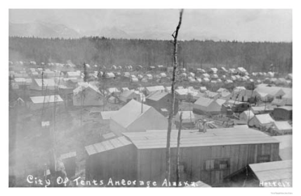
Anchorage
Was not a fishing nor mining town.
Had its origins from the building of the Alaska Railroad in 1914 – 1923.
The tent city located near the railroad headquarters at the mouth of Ship Creek grew and was incorporated to be Anchorage, Alaska on November 23, 1920

Slide 24
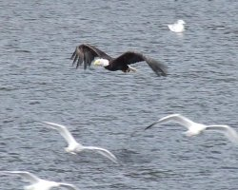
Turnagain Arm Bore Tide
The true tidal surge occurs when a rising tide enters a narrow and shallow basin.
Can reach heights up to six feet
Speeds of 10 - to 15 miles per hour
Wall of water is jumping with fish--salmon and hooligan
Masses of eagles and ravens fly along like a tornado as the bore tide roars in.

Slide 25
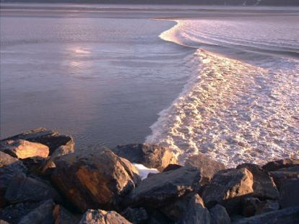
Turnagain Arm Bore Tide
Best areas to see the Turnagain Arm Bore Tide
Beluga Point - 20 minutes south of Anchorage to Portage about an hour south of town.
Five highway pullouts along this stretch.
The highway traverses the shoreline along the flats
Gives a real sense for the power and scale of the bore tide.

Slide 26
Day 12
Alaska Railroad serves not as the fastest mode of transportation to Mount McKinley but is one of the most relaxing possible.
Train travel offers an exciting way to see Alaska. The Alaska Railroad goes places inaccessible by road. Offering “whistle stop” service for passengers to disembark along the way for a quiet day of picnicking, fishing or hiking.
Glass-domed cars offer 180 degrees of scenery. A major rail station in Denali National Park provides one of the most favored methods of reaching this iconic national park.
The trip is a four to five hour drive from Anchorage or an eight hour train ride.

Slide 27
Ketchikan, Alaska
Sitka, Alaska
Juneau, Alaska
Anchorage, Alaska
Mount McKinley Ntl/ Park
Fairbanks, Alaska

Slide 28
Mount McKinley – Elevation: 20,320 feet
Koyukon Athabaskan people who inhabit the area around the mountain
Referred to the peak as Dinale or Denali
"the high one" or "the great one"
Highest Mountain in N. America
Has a summit elevation of 20,320 feet
Reaches 16,000 above the snowline
Coldest mountain outside of Antarctica
Summit area below 0⁰ F almost all times
Notes:
Mount McKinley (Denali) is the highest mountain in North America and perhaps the single most impressive mountain in the world--all higher peaks are in the greater Himalaya or in the Andes, part of enormous mountain ranges. McKinley rises almost alone, 16,000 feet above the snowline, with only nearby Mount Foraker even close to it in height. Although McKinley is part of the Alaska Range, a massive ice-clad range of spectacular peaks, it so utterly dominates its area that what would otherwise be major ice peaks sometimes seem like mere foothills.
McKinley is also perhaps the coldest mountain in the world outside of Antarctica--its combination of great height, high latitude, and terrible weather are literally unique. The summit area is below zero degrees Fahrenheit almost all of the time, and ferocious wind lashes the peak virtually incessantly.

Slide 29
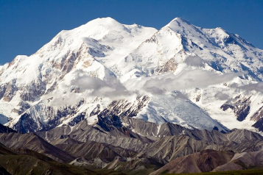
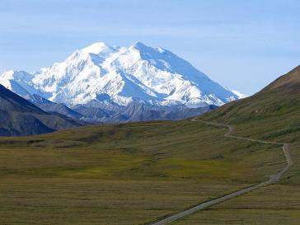
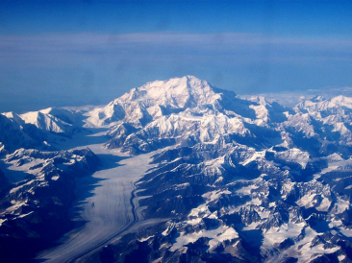
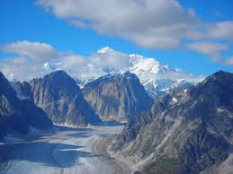
Mount McKinley
Five large glaciers flow off the slopes of the mountain.
Notes:
Mount McKinley (Denali) is the highest mountain in North America and perhaps the single most impressive mountain in the world--all higher peaks are in the greater Himalaya or in the Andes, part of enormous mountain ranges. McKinley rises almost alone, 16,000 feet above the snowline, with only nearby Mount Foraker even close to it in height. Although McKinley is part of the Alaska Range, a massive ice-clad range of spectacular peaks, it so utterly dominates its area that what would otherwise be major ice peaks sometimes seem like mere foothills.
McKinley is also perhaps the coldest mountain in the world outside of Antarctica--its combination of great height, high latitude, and terrible weather are literally unique. The summit area is below zero degrees Fahrenheit almost all of the time, and ferocious wind lashes the peak virtually incessantly.

Slide 30
Day 13 – Day 15
Once again the Alaska Railroad is the best possible choice for the last leg of the trip from Mount McKinley to Fairbanks, Alaska.
The tour guides for the trip are Alaskan students who have studied the history of the railroad, as well as the geography of the scenery, wildlife, etc. and they share their knowledge with you.
Famed for its glass-domed rail cars and excellent service.
"These cars feature some of the largest windows on passenger trains today.
The capacity ranges from 60-78 seats per car, depending on the car type.
Each has semi-reclining and forward facing seats. Parcel racks above keep carry-on luggage from under your feet. “
The 160 mile trip will take approximately 3 ½ - 4 hours on the train.

Slide 31
Ketchikan, Alaska
Sitka, Alaska
Juneau, Alaska
Anchorage, Alaska
Mount McKinley Ntl/ Park
Fairbanks, Alaska

Slide 32
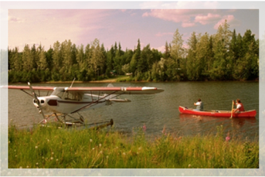
Fairbanks – Population: 31,535 Longitude/Latitude: 64.838 / -147.716
One of Alaska’s best year-round destinations
Lying in the interior of Alaska, it is a major transportation hub for the state providing terminals for air, rail and land travel.
Known for its seasonal temperature extremes.
Average January temperatures
-19⁰ to -2⁰ F but have been recorded as low as -62⁰F
Best time to see the Northern Lights
Average July temperatures
53⁰ to 72⁰ F, but as 96⁰ F in summer.
More than 22 hours of daylight when the solstice arrives on June 21.
Notes:
Officially the city of Fairbanks has 30,367 residents but the Fairbanks North Star Borough, including Ester and North Pole, has a population of almost 100,000, making this region the second largest population settlement in Alaska.

Slide 33
Fairbanks
Began as an energetic mining town at the center of the largest territories in the United States.
Gold was discovered in 1902
Trading Post was built on the Chena River
Incorporated by a 75% majority vote in 1903
By 1905, Fairbanks had a power plant, electricity and sewer services, a school, police and fire protection, a hospital and a three-story building.
Today, historic visitor attractions and modern-day mining operations still celebrate the quest for gold.
Notes:
Officially the city of Fairbanks has 30,367 residents but the Fairbanks North Star Borough, including Ester and North Pole, has a population of almost 100,000, making this region the second largest population settlement in Alaska.

Slide 34
Northern Lights
Aurora Borealis
Most dazzling from December to March when nights are longest and the sky darkest
At times the ribbon of lights may last for hours while others last only 10 – 15 minutes.
Myths & Legends
An Eskimo tale records that the northern lights are spirits playing ball in the sky with a walrus skull.
Another legend, calls them the flaming torches carried by departed souls guiding travelers to the afterlife.

Slide 36
Resources
Adventures, Tours & Attractions; http://www.traveljuneau.com/cms/d/attractions_and_adventures.php
Alaska; http://www.netstate.com/states/intro/ak_intro.htm
Anchor Inn By the Sea; http://www.alaskatravelers.com/ketchika1.htm
Biggest Cities Alaska; http://www.geonames.org/US/AK/largest-cities-in-alaska.html
Explore Fairbanks, Alaska - Gateway to Denali, Interior and Arctic; http://www.explorefairbanks.com
Major Alaskan Cities; http://www.alaskatourdirectory.com/parks-and-destinations/major-alaskan-cities.aspx
Mapquest; www.mapquest.com
More than you can Imagine, Closer than you think; http://www.sitka.org/
WEST ROCK ALASKA TOURS; http://www.snowscove.com/Seal%20Lions%20and%20Whales%20Tour%20Destination/Sea%20Lions%20and%20Whales%20Tour.index.htm

