Slide 1
Cloud Computing
Notes:
What is cloud computing? Cloud computing is the next stage in evolution of the Internet. Cloud computing provides the means through which everything — from computing power to computing infrastructure, applications, business processes to personal collaboration — can be delivered to you as a service w

Slide 2
Cloud Computing
new buzz word
driven largely by marketing and service offerings
Provided by big corporate players
Google
IBM
Amazon
Apple

Slide 3
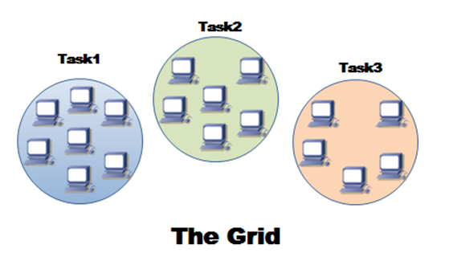
History
1990’s
Development of “the grid” by connecting machines together to create a massive, shared pool of storage and computing power.
Used resources to create on that would be much larger than what any one institution could afford to build.
Notes:
n the early 1990s, the budding Internet finally had enough computers attached to it that academics began thinking seriously about how to connect those machines together to create massive, shared pools of storage and compute power that would be much larger than what any one institution could afford to build. This is when the idea of "the grid" began to take shape.

Slide 4
Grid Computing
Required the use of software that can divide and farm out pieces of a program as one large system to several thousand computers.
Problem
If one piece of the software node fails, other pieces of the software on other nodes may fail.
Large system images and associated hardware to operate and maintain could contribute to large capital & operating expenses.
Notes:
Grid computing requires the use of software that can divide and farm out pieces of a program as one large system image to several thousand computers. One concern about grid is that if one piece of the software on a node fails, other pieces of the software on other nodes may fail. This is alleviated if that component has a failover component on another node, but problems can still arise if components rely on other pieces of software to accomplish one or more grid computing tasks. Large system images and associated hardware to operate and maintain them can contribute to large capital and operating expenses.

Slide 5
Cloud Computing
Evolved from grid computing & provides on-demand resource provisioning.
Notes:
Cloud computing evolves from grid computing and provides on-demand resource provisioning. Grid computing may or may not be in the cloud depending on what type of users are using it. If the users are systems administrators and integrators, they care how things are maintained in the cloud. They upgrade, install, and virtualize servers and applications. If the users are consumers, they do not care how things are run in the system.

Slide 6
Grid vs. Cloud
Grid – Large job is divided into many small portions and executed on multiple machines.
Cloud - Intended to include delivery of software, infrastructure, and storage over the Internet based on the user’s demand.
Notes:
The difference between grid computing and cloud computing is hard to grasp because they are not always mutually exclusive. In fact, they are both used to economize computing by maximising existing resources. However, the difference between the two lies in the way the tasks are computed in each respective environment. In a computational grid, one large job is divided into many small portions and executed on multiple machines. This characteristic is fundamental to a grid; not so in a cloud. The computing cloud is intended to allow the user to avail of various services without investing in the underlying architecture.
Cloud services include the delivery of software, infrastructure, and storage over the Internet (either as separate components or a complete platform) based on user demand.

Slide 7
Advantages
On demand Service
Customer simply requests and amount of computing, storage, software, process or other resources from the service provider.
Elasticity
Provides the ability to scale up & down
when additional users are added
When application requirements change.
Cost Reduction
By purchasing just the right amount of IT resources on demand the organization can avoid purchasing unnecessary equipment.
Application Programming Interfaces
Accessibility to software that enables machines to interact with cloud software .
Notes:
On demand service provisioning: by using Self-service provisioning customers can easily get cloud services without going through a lengthy process. The customer simply requests an amount of computing, storage, software, process, or other resources from the service provider. Elasticity: that is simple to add more stuff. Cloud computing provides the ability to scale up and down when additional users are added and when the application requirements change.
Cost reduction: As a matter of fact, companies are often challenged to increase the functionality of IT while minimizing capital expenditures. By purchasing just the right amount of IT resources on demand the organization can avoid purchasing unnecessary equipment.
Application programming interfaces (APIs): accessibility to software that enables machines to interact with cloud software in the same way the user interface facilitates interaction between humans and computers. Cloud Computing systems typically use REST based APIs.

Slide 8
Landscape of Cloud Computing
Public Cloud
Resources offered as a service & shared across multiple organizations, managed by an external service provider.
Private Cloud
Resources dedicated to a single organization and offered on demand.
Hybrid Cloud
Mix of private and public clouds managed a single entity to extend capacity across clouds as needed.
Notes:
Public Cloud: IT resources offered as a service and shared across multiple organizations, managed by an external service provider Private Cloud: IT resources dedicated to a single organization and offered on demand Hybrid Cloud: a mix of private and public clouds managed as a single entity to extend capacity across clouds as needed

Slide 9
Examples -
Social Networking
Facebook, Linkedin, MySpace, Twitter
Email
Hotmail, Windows Live Mail,
Document/Spreadsheet/Other hosting
Google Drive, SkyDrive, Zoho Office, Flickr, Onit, YouTube
Backup Services
JungleDisk, Carbonite, Syncplicity, Dropbox.
Banking and Financial Services
Storing of Banking and Tax Records and Information
Health Care
Electronic Health Record (HER), Google Health, Microsoft HealthVault

