Slide 1
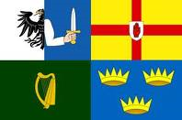
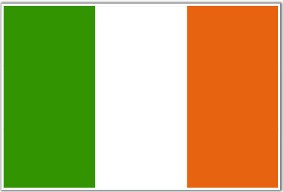
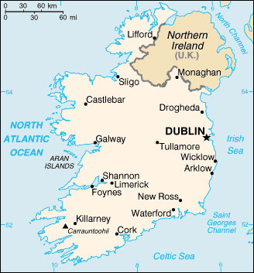
Ireland
My Ancestors Homeland
Notes:
The third-largest island in Europe and the twentieth-largest island in the world.^{[4]} It lies to the northwest of continental Europe and is surrounded by hundreds of islands. To the east of Ireland is Great Britain, separated from it by the Irish Sea. The island is divided between the Republic of Ireland, which covers just under five-sixths of the island, and Northern Ireland, a part of the United Kingdom, which covers the remainder and is located in the northeast of the island. The population of Ireland is approximately 6.2 million people. Just under 4.5 million live in the Republic of Ireland and just under 1.8 million live in Northern Ireland.^{[3]}

Slide 2
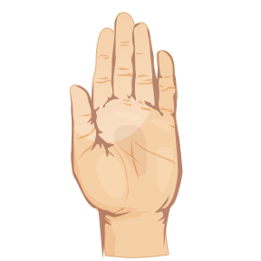
Verbal and Non Verbal Greetings
Verbal Greetings
Dia duit - God to you
Go mbeannai - May God bless you
Non Verbal
Nodding and acknowledging
Hand Gestures
Spitting In Hand
Notes:
In rural Ireland people still acknowledge each other in passing with a nod or hello even to strangers. A habit that needs keeping in check when in the city. Car drivers in rural areas also acknowledge each other with a hand gesture which differs from townland to townland, some being very individualized At horse fairs or cattle fairs when a deal is done they'll spit in their hand and shake on it.

Slide 3
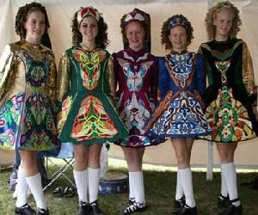
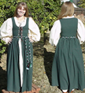
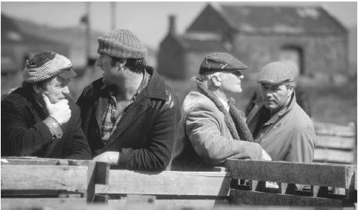
Traditional Clothing

Slide 4
Holidays In Ireland
Lá Caille or Lá Bliana Nua – NewYear’s Day
January 1
Lá Fhéile Pádraig – St. Patrick’s Day
March 17
Lá Nollag – Christmas Day
December 25
Lá Fhéile Stiofáin or Lá an Dreoilín – Saint Stephen
December 26
Notes:
New Year’s Day - Most also take time off work for New Year's Eve (Oíche Chinn Bliana).
St. Patrick’s Day – National Day
Christmas Day - Most start Christmas celebrations on Christmas Eve (Oíche Nollag), including taking time off work.
Saint Stephen - The day after Christmas celebrating the feast day of Saint Stephen. Lá an Dreoilín translates as the Day of the Wren.

Slide 5
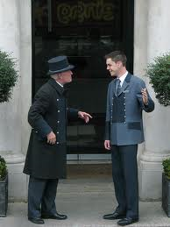
Languages
English
Official Language
Gaelic
Irish
Notes:
English (official) is the language generally used, however the Irish (Gaelic or Gaeilge) (official) is spoken mainly in areas along the western coast

Slide 6
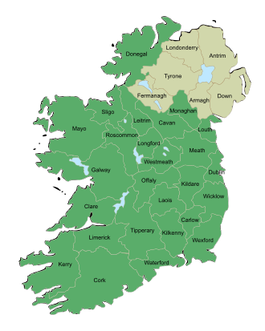
Governing Body
Ireland is subdivided into four provinces:
Connacht (west)
Leinster (east)
Munster (south)
Ulster (north).
Ireland has thirty-two traditional counties.
Twenty-six of the counties are in the Republic of Ireland
Six counties are in Northern Ireland. Which is governed by the United Kingdome.
Parliamentary Democracy system of government
Notes:
Traditionally, Ireland is subdivided into four provinces: Connacht (west), Leinster (east), Munster (south), and Ulster (north). In a system that developed between the 13th and 17th centuries,^{[65]} Ireland has thirty-two traditional counties. Twenty-six of the counties are in the Republic of Ireland and six counties are in Northern Ireland.
Parliamentary democracy - a political system in which the legislature (parliament) selects the government - a prime minister, premier, or chancellor along with the cabinet ministers - according to party strength as expressed in elections; by this system, the government acquires a dual responsibility: to the people as well as to the parliament.

Slide 7
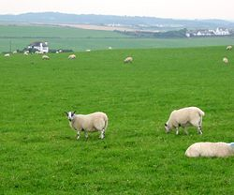
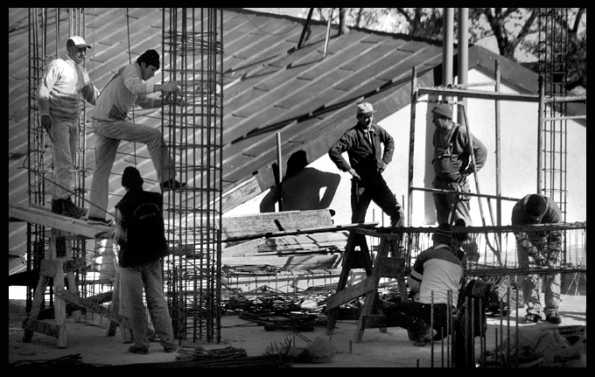
Industries
Agriculture
Construction
Notes:
Agriculture, once the most important industry in Ireland, is now dwarfed by industry and services such as construction of businesses and building new homes.
This burst of industry in construction most recently fueled economic growth along with strong consumer spending and business investment

Slide 8
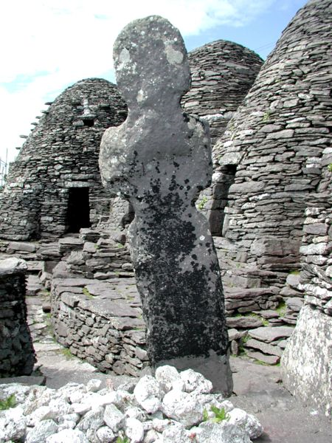
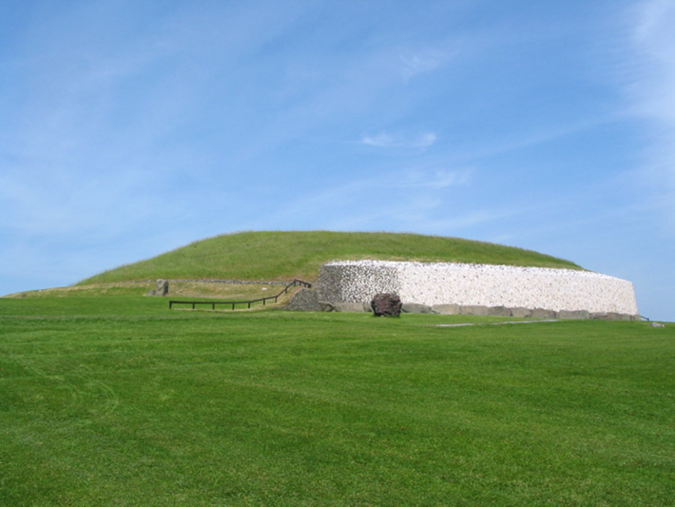
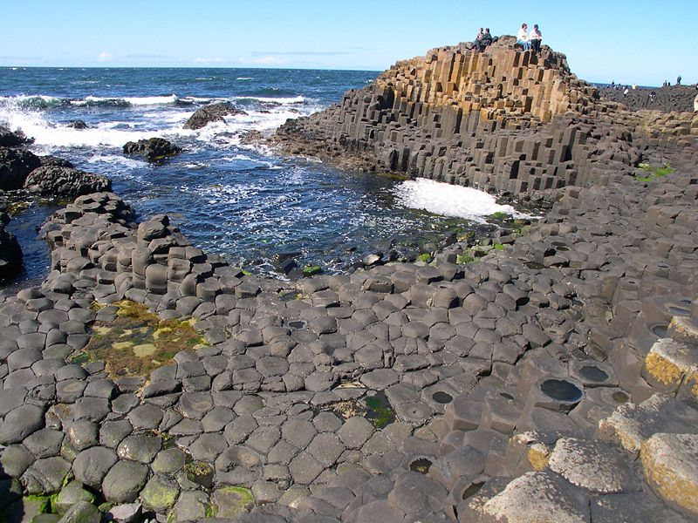
World Heritage Sites in Ireland
Brú na Bóinne County Meath
Giant's Causeway County
Antrim
Skellig Michael County Kerry
Notes:
Giant’s Causeway is an area of about 40,000 interlocking basalt columns, They were formed as a result of an ancient volcanic eruption.
It was declared a World Heritage Site by UNESCO in 1986, and a National Nature Reserve in 1987 by the Department of the Environment for Northern Ireland. In a 2005 poll of Radio Times readers, the Giant's Causeway was named as the fourth greatest natural wonder in the United Kingdom.^{[2]}
Skellig Michael also known as Great Skellig, is a steep rocky island in the Atlantic Ocean about 9 miles (14.5 kilometres) from the coast of County Kerry, Ireland. It is the larger of the two Skellig Islands. Since the extreme remoteness of Skellig Michael has until recently discouraged visitors, the site is exceptionally well preserved.
^{Bru na Boinne -} is the largest and one of the most important prehistoric megalithic sites in Europe.
The site contains around 40 passage graves, as well as other prehistoric sites and later features. The majority of the monuments are concentrated on the north side of the river. The most well-known sites within Brú na Bóinne are the impressive passage graves of Newgrange, Knowth and Dowth, all famous for their significant collections of megalithic art. Each stands on a ridge within the river bend and two of the tombs, Knowth and Newgrange, appear to contain stones re-used from an earlier monument at the site.

Slide 9
Tourism in Ireland

Slide 10
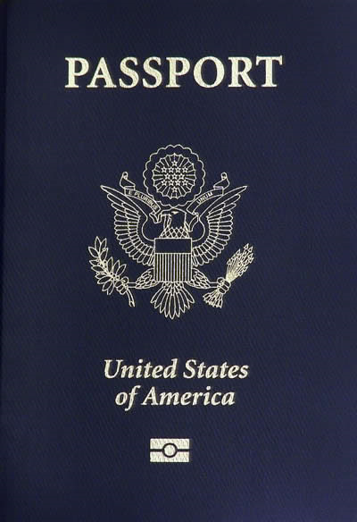
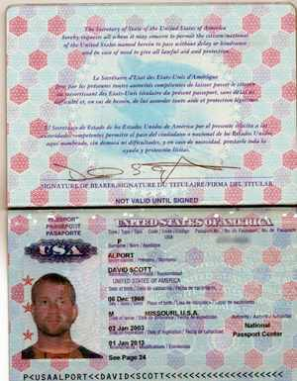
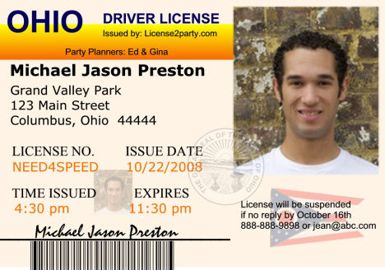
Travel Requirements
Passport
Valid State ID
Notes:
For a resident of the United States to travel to Ireland, they would need a Passport and State ID such as a driver’s license.

Slide 11
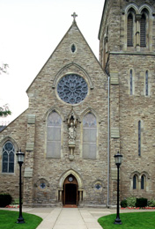
Primary Religions
Christianity
Roman Catholic Church
Presbyterian Church
Methodist Church
Church of Ireland (Anglican)
Notes:
The predominant religion in Ireland is Christianity, with the largest church being the Roman Catholic Church. Ireland's constitution states that the state may not endorse any particular religion and guarantees freedom of religion.
Other significant Protestant denominations are the Presbyterian Church in Ireland, followed by the Methodist Church in Ireland. The second largest Christian denomination, the Church of Ireland (Anglican),

Slide 12
5 Myths About Ireland
Wear green
Wear Wool Sweaters
Leprechauns
People are Poor
Northern Ireland
Notes:
1. People in Ireland wear green
Just because they everyone does it on St. Patrick’s Day, doesn’t mean they do it on every other day.
Indeed, even on the national holiday, the Irish themselves typically DON’T wear green – this tradition is today observed more by visitors to Ireland, or by Irish descendants and friends abroad.
2. People in Ireland wear Aran sweaters
3. Leprechauns live in Ireland
In places like the US, the words “Ireland” and “leprechaun” are synonymous. In Ireland, however, leprechauns are nowhere to be seen. Not just in the flesh – there are no leprechaun dolls, leprechauns toys, or leprechauns cartoon characters on cereals boxes.
4. Irish people are poor
On the contrary, Irish people are among the wealthiest in Europe, and the cost of living is quite high. Take a look at some restaurant menus and prices online, before coming, to get an idea of what you’ll need to budget.
5. Northern Ireland is dangerous
The “troubles” in Northern Ireland – the low-level guerrilla war between (mainly) the IRA and the British government – are more or less over.

Slide 13
Bibliography
http://en.wikipedia.org/wiki/Ireland#Places_of_interest
https://www.cia.gov/library/publications/the-world-factbook/geos/ei.html

