Slide 1
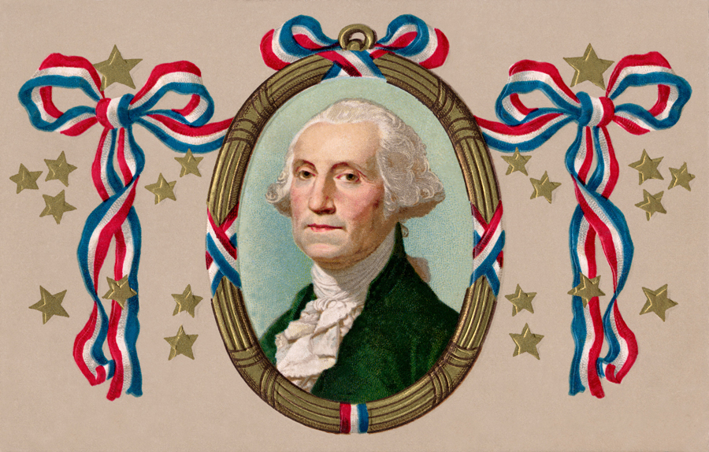
American History
Flash Cards

Slide 2
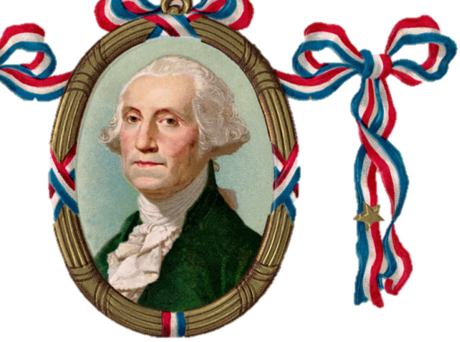
Cause and Effect
Why did the colonists fight the British?
Karole McGrew
Introduction to Computers
3-4

Slide 3
Question 1 Cause and Effect
Why did the colonists fight the British?
because of high taxes (taxation without representation)
because the British stayed in their houses (boarding, quartering)
because they didn’t have self-government
because

Slide 4
Question 2
Who wrote the Declaration of Independence, and when was it adopted?

Slide 5
Question 2
Who wrote the Declaration of Independence, and when was it adopted?
July 4, 1776
Thomas Jefferson

Slide 6
Question 3
Under the pseudonym “Publius,” who wrote the Federalist Papers?

Slide 7
Question 3
Under the pseudonym “Publius,” who wrote the Federalist Papers?
Alexander Hamilton
James Madison
John Jay

Slide 8
Don’t forget to be a:
Study
Take notes
Ask questions
Review with a friend
STAR

