Slide 1
About Our Business
Mongibello
ARTISAN PASTA
Mongibello Artisan Pasta

Slide 2
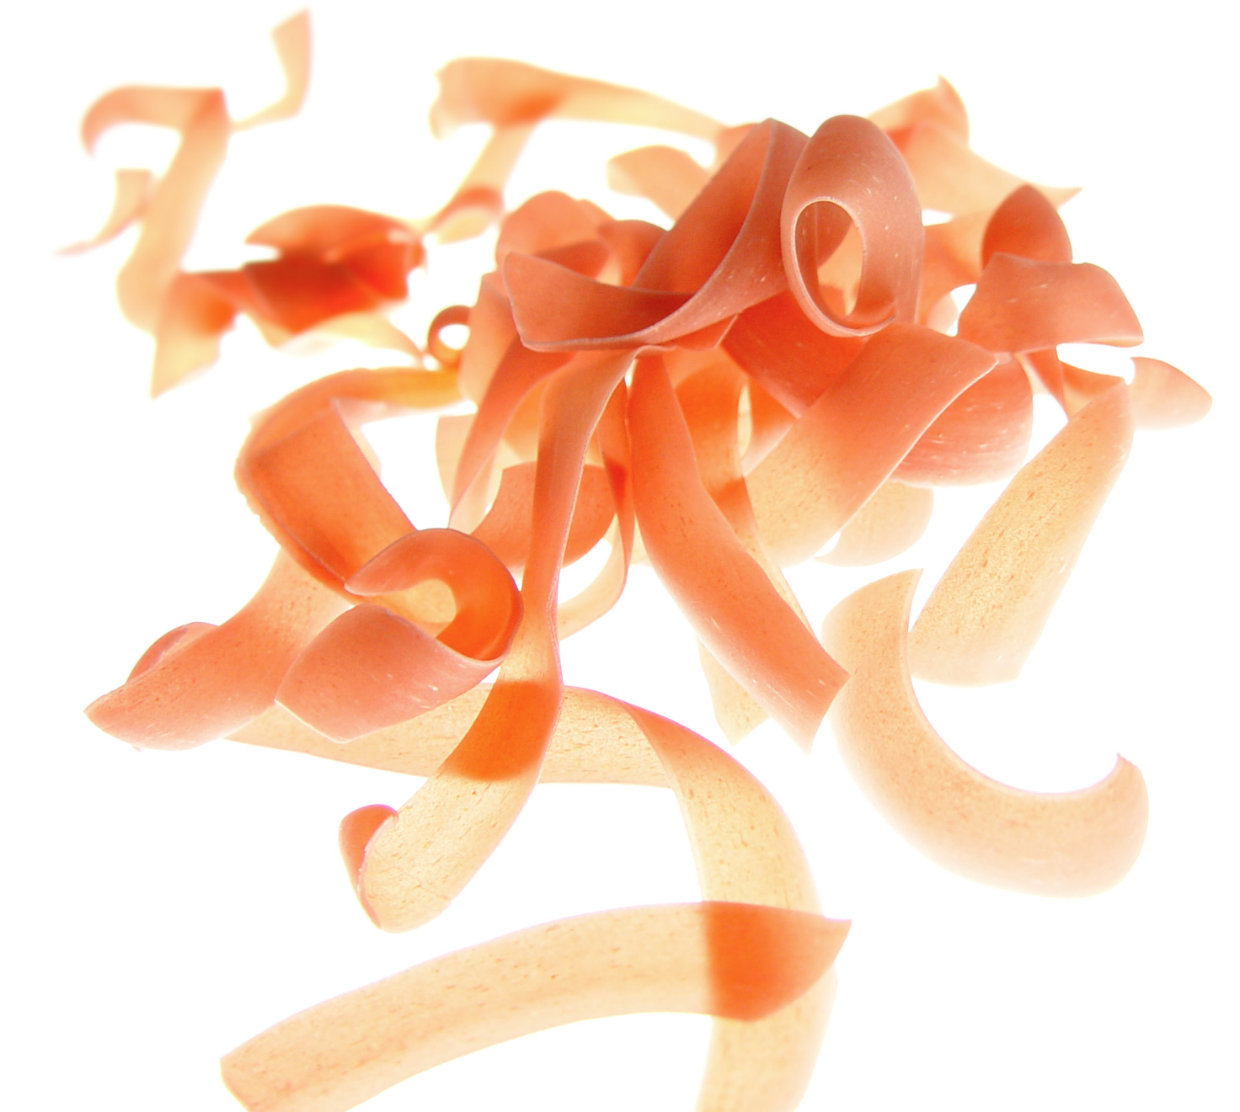
Our Mission
Mongibello
ARTISAN PASTA
To create unique, high quality pastas, made by hand without additives or preservatives, for restaurants and individuals who choose to serve delicious, all-natural, one-of-a-kind pastas.

Slide 3

Our Team
Mongibello
ARTISAN PASTA
Owner Shel Rheingold (with Manager Stefan Linn) leads a talented team of two with over 30 years of experience making pasta by hand, crafting unique flavors that tantalize the palate, and pushing the boundaries of traditional artisan pasta-making.

Slide 4
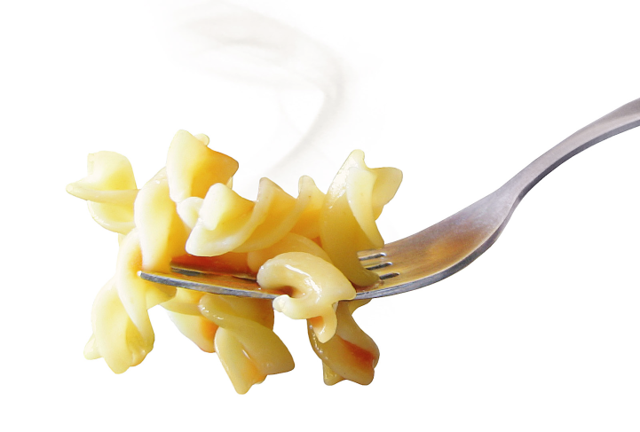
Let’s Compare
Mongibello
ARTISAN PASTA
Them
Us
Traditional pasta flavors
Conventional use of all-natural dyes; limited color palette
Repetitive die cut process
Unique flavors built on tradition
Innovative use of all-natural dyes; wider color palette
Minimal die cut process

Slide 5
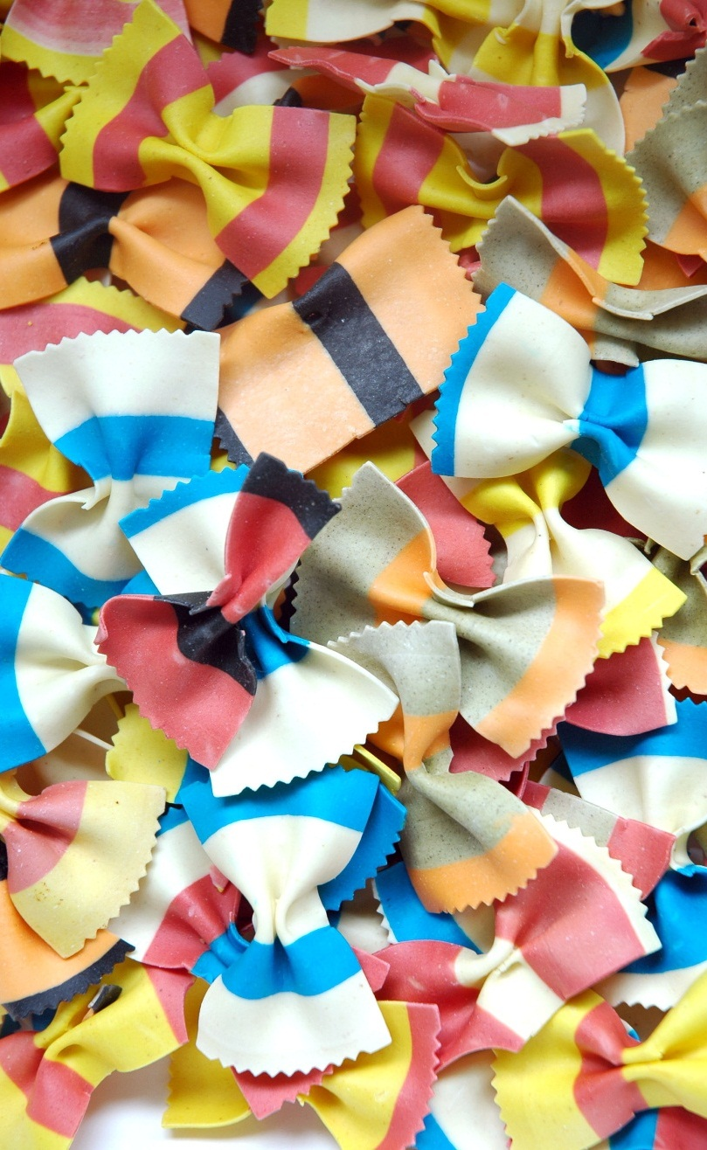
The Goods
Mongibello
ARTISAN PASTA
Zesty Black Bean Fettuccini
Sundried Tomato Fettuccini
Thai Basil Fettuccini
Roasted Red Pepper Penne
Massaman Curry Penne
Wild Mushroom Penne
Shel’s Spanakopita Bowties
Stefan’s Striped Bowties

Slide 6
Shop, or Visit Our Kitchen
Mongibello
ARTISAN PASTA
1009 Craftsman Drive
Portland, Maine
Hours
9:00-5:00 Tues-Sun
Closed Mon
Contact
207-555-1145
shel@bellopasta.com

