Slide 1
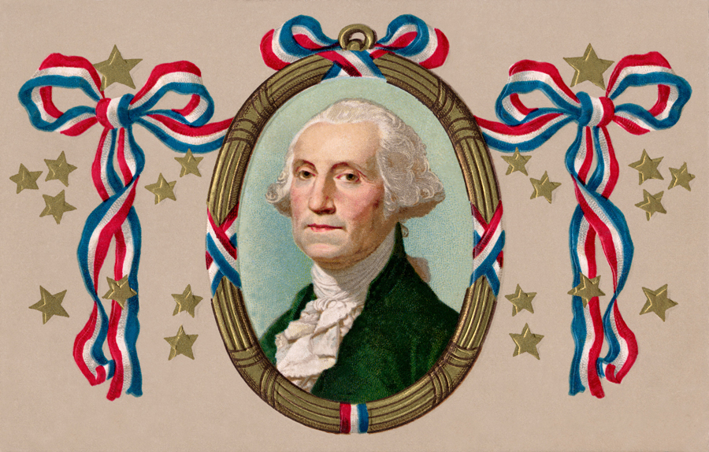
American History
Flash Cards

Slide 2
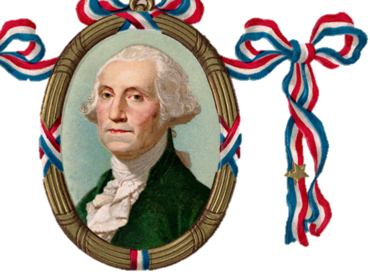
Why did the colonists fight the British?

Slide 3
Question 1
Why did the colonists fight the British?
because of high taxes (taxation without representation)
because the British stayed in their houses (boarding, quartering)
because they didn’t have self-government
because

Slide 4
Question 2
Who wrote the Declaration of Independence, and when was it adopted?

Slide 5
Question 2
Who wrote the Declaration of Independence, and when was it adopted?
July 4, 1776
Thomas Jefferson

Slide 6
Question 3
Under the pseudonym “Publius,” who wrote the Federalist Papers?

Slide 7
Question 3
Under the pseudonym “Publius,” who wrote the Federalist Papers?
Alexander Hamilton
James Madison
John Jay

Slide 8
Don’t forget to be a:
STAR
Study
Take notes
Ask questions
Review with a friend

