Slide 1
Texlahoma High School
Terrier Tough!
Band Boosters Meeting
July 1, 2010

Slide 2
Agenda
New Officers
Elections and Thank You
Announce New Officers
Distribute Officer Contact Info
Fundraising
Past and Present Ideas
Review Yearly Results

Slide 3
New Officer Announcement
2010-2011 School Year

Slide 4
Elections and Appreciation
Elections were held in June for new Texlahoma High Band Booster officers for the 2010-11 school year.
Before we welcome our new officers, we want to give a huge Thank You to our
2009-2010 officers for a spectacular year!

Slide 5
New 2010-11 Band Booster Officers
Officer Position | Member
President | Ms. Sara Morales
Vice President | Mr. Terrance Miller
Accounting | Ms. Sandra Lee
Fundraising Chair | Ms. Julia Stevens
Secretary | Mrs. Gwen Pierce
Congratulations & Welcome!

Slide 6
Fundraising
Past and Future

Slide 7
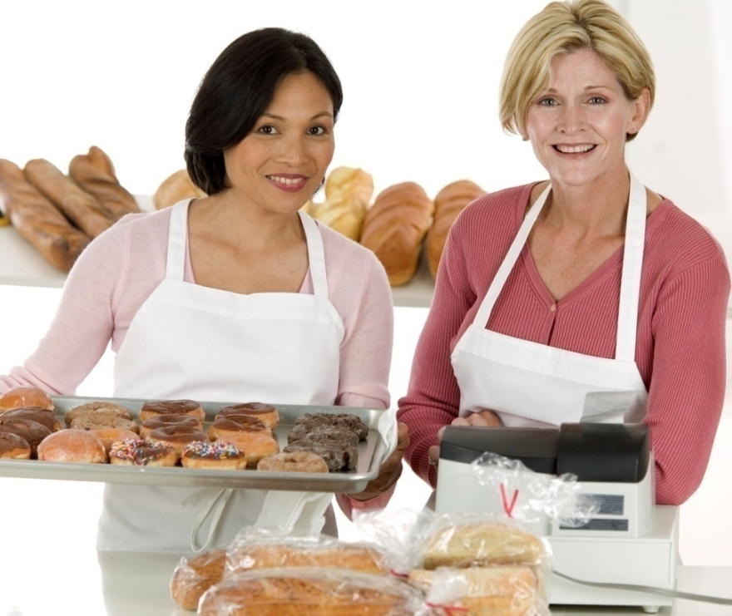
Possible Fundraising Projects
Previous Projects
Doughnut Sale
Candy Bar Sale
Walk-a-thon
Wrap Gifts at Local Mall
Card Kit Sales
New Project Ideas
Candy-grams for Kids
Car Wash
Idol Contest – Pay Per Vote

Slide 8
Past Fundraising Results

Slide 9
Choose 2010-2011 Projects
Need to choose fundraising projects
5 projects per school year
Each lasts 6 weeks, with 2 week break in between
Need Project Coordinators
Review monetary benefits of projects
Project Coordinators Responsibility:
Best way to coordinate project
For Suggestions or Participation, contact:
Julia Stevens, Fundraising Chair at jstevens68@email.com

Slide 10
Next Meeting
July 15, 2010

Slide 11
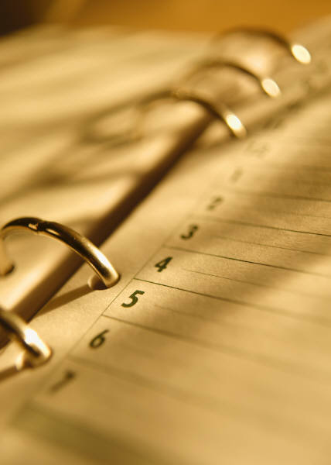
See You Next Month!
Next Meeting:
July 15th - 7 p.m.
Back to School – Recruit New Members
Finalize Fundraising Calendar and assign coordinators

