Slide 1
Computer Concepts
Unit A

Slide 2
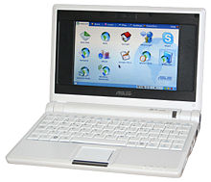
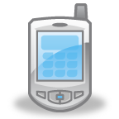
Types of Computers
Personal Computers (PCs)
  Desktop – sits on a desk
  Laptop (Notebooks) & Mini Computers
  Netbooks (primarily Internet/E-mail access)
  Hand-Held Computers
    Smart Phones, MP3 Players, IPODs
Mainframe Computers – Large bus/govt. agencies
  Centralized storage, processing, management of data
Supercomputers – largest/fastest computers
  Large volume of data for large corporations/govt.
Notes:
PCs – Single user – home or office, WP, photos, email, Internet access
Smart Phones – make/receive calls, address bk, appt. calendar, calculator, notepad, send email, Internet, music, photos/videos
MP3 Players & IPODs– store/play music, some play digital movies/tv
Supercomputer – picture shown on page 3

Slide 3
Mainframe Computers
Used by larger businesses and government agencies
  Allows management for large amounts of data.
  Provide centralized storage
  Processing
Expensive
  Cost varies widely from several thousand dollars to one million dollars.

Slide 4
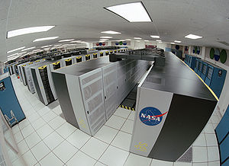
Supercomputers
Largest and Fastest
  Used by large corporations and government agencies
  Is able to process and store tremendous volumes of data
Can Cost Millions of Dollars

Slide 5
Converging technologies
Every year the lines between the types of computers are growing more and more blurry.
  Handheld devices and smart phones are more powerful than the first laptops
  Today’s desktop PCs are far more powerful than the mainframe computers of a few decades ago.
As new technologies are developed, consumers will need fewer and fewer devices to accomplish their tasks.

Slide 6
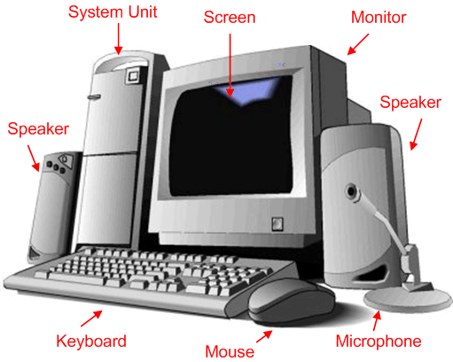
Computer Systems
Hardware
  Physical components of a computer

Slide 7
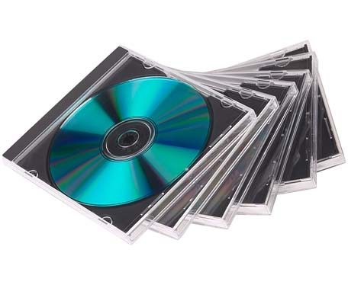
Computer systems
Software
  Refers to the intangible components of the computer system
    Operating System
      Special software that controls
        basic input and output
        Allocates system resources
        Manages storage space
        Maintains computer security
        Detects equipment failure
    Application Software
      Programs that are utilized by the user to do a specific task.

Slide 8
Computer systems
Data
  Refers to the words, numbers, figures, sounds and graphics that describe people, events, things and ideas.
Processing
  The process of the computer taking the Raw Data and completing the required modifications to create a useful output.

Slide 9
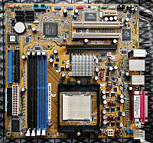
Computer systems
Motherboard
  Located inside the computer
  Main electronic component of the computer

Slide 10
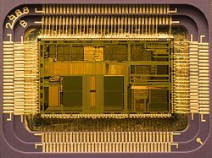
Computer systems
Motherboard
  Contains the following processing hardware
    Microprocessor – also called the CPU (Central Processing Unit)
      Consists and electronic circuits on a silicon chip
      Mounted on the Motherboard
      Follows the commands given by the software. The commands tell the computer how to process the data.
    Cards – Removable circuit boards that are inserted onto the slots in the motherboard to expand the capabilities of the motherboard.

Slide 11
Computer Systems
Input
  Data or instructions that are entered into the computer
    Keyboard
    Mouse
    Microphone
Output
  The result of the computer processing input
    Monitor
    Printer
    Speakers

Slide 12
Memory
RAM – Random Access Memory
  Temporarily holds programs and data while the computer is on and allows the computer to access the information randomly
ROM – Read Only Memory
  Chip on the motherboard that has been preloaded with Data.
  Permanently stores the set of instructions that the computer uses to check the computer system’s components to make sure they are working and to activate the essential software that operates the processing of the computer

Slide 13
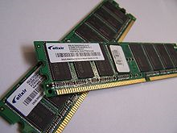
Memory
RAM Memory
  Doesn’t need to access data in the same order as it was stored on the computer.
  One of the easiest ways to make your computer fun faster is to add more RAM.

Slide 14
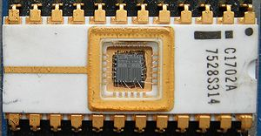
Memory
ROM Memory
  BIOS – The set of instructions contained in the ROM Memory
    Tells the computer to initialize the motherboard, how to recognize devices connected to the computer, start the boot process.
  CMOS Memory– Complementary Metal Oxide Semiconductor
    Chip installed on the motherboard that is activated during the boot process that identifies where essential software is located during the boot process
    Changes each time you add or remove hardware to the computer

Slide 15
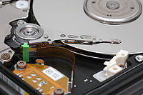
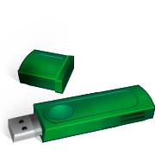
Storage media
Magnetic Storage Media
  Also known as the Hard Drive of the computer system.
USB Flash Drive
  Plug directly into the USB port of the computer
  The computer recognizes the device as another disk drive.

Slide 16
Storage Media
CD
  Can store about 700 MB of data (1024 MB =1 GB)
DVD
  Can store about 4.7 GB to 15.9 GB of data, depending on whether the data is stored on one or both sides of the disk.
Blu-Ray
  Can store 25 GB of data per layer. Used for storing high definition video.

Slide 17
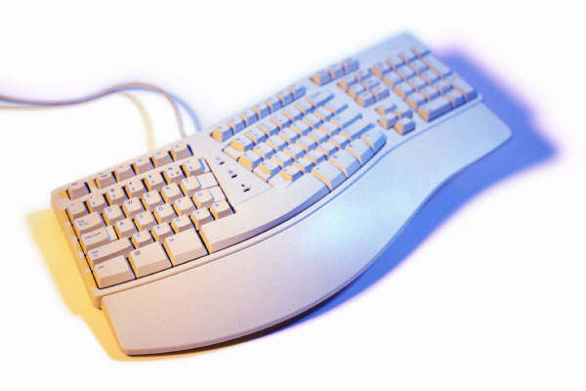
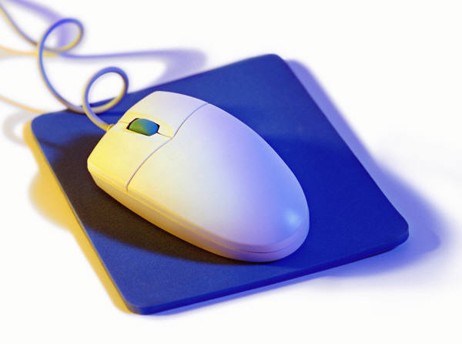
Input Devices
Classified as Peripheral Devices
  Keyboard
    Most Common Input Device
  Mouse
    Pointer device sued to select commands and manipulate text or graphics on the screen
  Scanner
    Device that transfers the content on a piece of paper into memory.

Slide 18
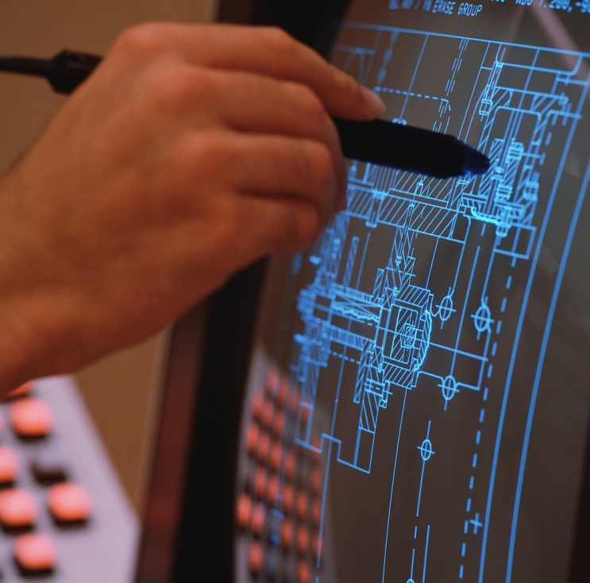
Input Devices
  Touchscreen
    Output device that also allows for the input of data
      ATM
      Smartphones
      MP3 players
  Microphones
    Used to record sound to be used as data on the computer system.

Slide 19
Output
Classified as a Peripheral Device
  Monitor
    Most Common Output Device
  Printer
    Produces a hard copy (Paper Copy) of a file
  Speakers
    Allows you to hear sounds from the computer.
    For speakers to work, a sound card must be installed on the computer.

Slide 20
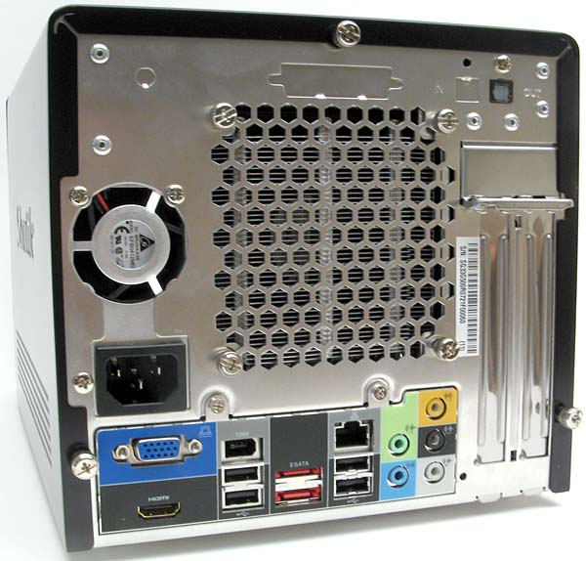
Expansion Ports
Allows for the attachment of a peripheral device

Slide 21
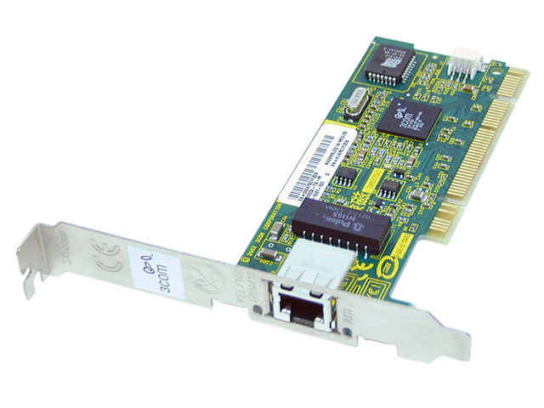
Networking
Network
  Connects one computer to other computers and peripheral devices
  Allows the sharing of data and resources such as a printer.
NIC – Network Interface Card
  Each computer that is part of the network must have a NIC installed.
  Creates a communications channel between the computer and the network.

Slide 22
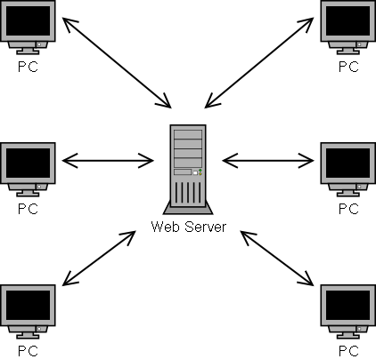
Server
Acts as the central storage location for programs and provide mass storage for most of the data used on the network.
Data is not stored on the individual computers. If a computer dies, the data is safe on the server.

Slide 23
Networking
LAN – Local Area Network
  Computers and peripheral devices are located relatively close to each other…generally in the same building.
WAN – Wide Area Network
  More than one LAN connected together
  Largest WAN is the Internet.
WLAN Wireless Local Area Network – (WI-FI)
  Computers and peripherals use high-frequency radio waves instead of wires to communicate and connect in a network.

Slide 24
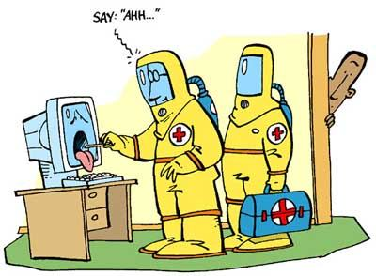
Security Threats
Virus
  Program deliberately created to instruct the computer system to perform destructive activities such as erasing a disk drive
Antivirus Software
  Created to find, correct and destroy the virus that has been installed on the computer system.

Slide 25
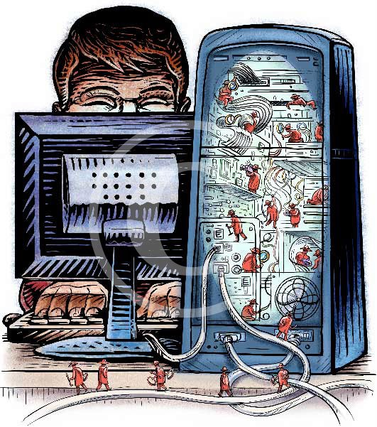
Security threats
Spyware
  Software programs that contain other programs that tracks a computer user’s Internet usage and send the data back to the company or person that created it.
Anti-Spyware
  Can detect these programs and deletes it.

Slide 26
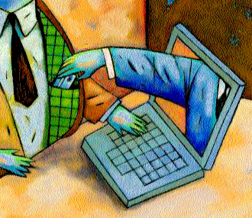
Security threats
Phishing
  Practice of sending e-mails to customers or potential customers of a legitimate Web site asking them to click a link in the e-mail. If the link is clicked on the browser often asks personal information.

Slide 27
Security threat protection
Firewall
  Prevents other computers on the Internet from accessing your computer and prevents programs on it form accessing the Internet without your permission.
Can either be a in the form of:
  Hardware
    Provides a physical door that protects the computers attached.
  Software
    Tracks all incoming and outgoing traffic on the internet. If a program that never accessed the Internet before attempts to do so, the user is notified and can choose to forbid access.

Slide 28
Security threat protection
Passwords
  The use of a password is the very first level of protection for your computer system.
  To prevent anyone from guessing your passwords, you should always create and use strong passwords.
    Consists of at least eight characters of upper and lowercase letters and numbers.
    Avoid using common personal information, such as birthdays and addresses in your password.

Slide 29
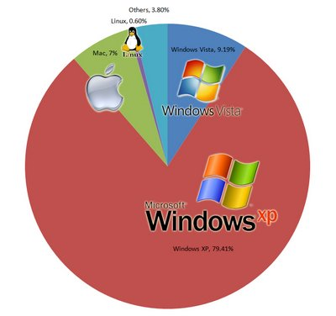
System software
Operating System Software
  Allocates system resources
  Manages storage space
  Maintains system security
  Detects equipment failure
  Controls basic Input/Output
Examples
  DOS, Windows 3.1, Windows 95, Windows XP, Vista, System 7
  Apple -

