Slide 1
Microsoft Word 2010 - Illustrated
Unit B:
Editing Documents

Slide 2
Objectives
Cut and paste text
Copy and paste text
Use the Office Clipboard
Check spelling and grammar

Slide 3
Cutting and Pasting Text
The operation of moving text from one location to another is called cut and paste
Cutting text removes it from the document
Cut text is placed on the Clipboard, a temporary storage area for text and graphics cut or copied from a document
Two clipboards:
System Clipboard - holds one item, the last item cut or copied from a document
Office Clipboard - holds up to 24 items
Notes:
The editing features in Word allow you to move text from location to another in a document. Moving text is often called cut and paste. When you cut text, it is removed from the document and placed on the clipboard, a temporary storage area for text and graphics that you cut or copy from a document.

Slide 4
Cutting and Pasting Text (continued)
Cut the selected text using the Cut button in the Clipboard group on the Home tab or the keyboard shortcut [Ctrl][X]
Paste text at the location of the insertion point using the Paste button in the Clipboard group on the Home tab or the keyboard shortcut [Ctrl][V]
Notes:
You can then paste, or insert, text that is stored on the Clipboard in the document at the location of the insertion point. You cut and paste text using the Cut and Paste buttons in the Clipboard group on the home tab.

Slide 5
Cutting and Pasting Text (continued)
You can also move text using the drag and drop method
Drag selected text to a new location using the mouse
Text that is dragged is not placed on the Clipboard
Notes:
You can move selected text by dragging it to a new location using the mouse. This operation is called drag and drop.

Slide 6
Keyboard Shortcuts
A shortcut key is a function key such as [F1], or a combination of keys, such as CTRL S
Copy – CTRL C
Cut – CTRL X
Paste – CTRL V
Save – CTRL S
Becoming skilled at using keyboard shortcuts can help you quickly accomplish many of the tasks you perform in word.

Slide 7
Cutting and Pasting Text (continued)
Use keyboard shortcuts as a quick way to perform a command
[Ctrl][X] to cut text
[Ctrl][C] to copy text
[Ctrl][V] to paste text
[Ctrl][A] to select all the text in a document
[Ctrl][S] to save a document
The keyboard shortcut for a command appears in the ScreenTip

Slide 8
Learning Activity
Complete Cutting and Pasting Text on Page Word Unit B page 26.
Open WD B-1.docx.
Save it as WDB-Lecture PR

Slide 9
Copying and Pasting Text
Copied text is not removed from the document
A copy of the copied text is placed on the Clipboard
Use the Copy button in the Clipboard group on the Home tab or the keyboard shortcut [Ctrl][C]
Copy selected text by pressing [Ctrl] as you drag it to another location
Notes:
Copying and pasting text is similar to cutting and pasting text, except that the text you copy is not removed from the document. Rather, a copy of the text is placed on the clipboard, leaving the original text in place. You can copy text to the Clipboard using the copy button in the clipboard group on the Home tab, or you can copy text by pressing CTRL as you drag the selected text from one location to another

Slide 10
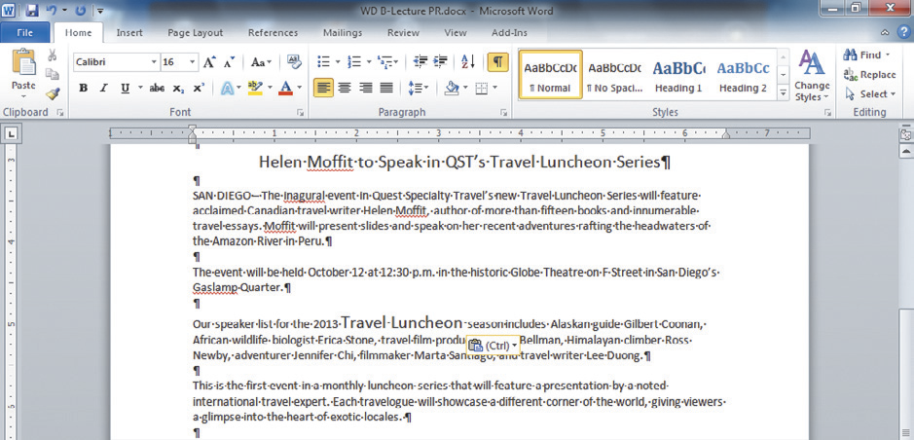
Copying and Pasting Text (continued)
The Paste Options button allows you to change the formatting of pasted text
Copied text
Paste Options button
Pasted text

Slide 11
Copying and Pasting Text (continued)
Split a document window into two panes
Useful when you want to copy and move items in a long document
Use the Split button in the Window group on the View tab
Drag the horizontal split bar to the location you want to split the window
Use the scroll bars in each pane to display different parts of the document
Use the Cut, Copy, and Paste commands to copy or move items between panes

Slide 12
Learning Activity
Complete the learning activity on page Word Unit B page 28.

Slide 13
Checking Spelling and Grammar
Spelling and Grammar checker
Flags possible mistakes and suggests corrections
Misspelled words
Grammar errors
Not all flagged errors are incorrect (e.g. names)
Click Ignore All or Ignore Once so Word does not flag the word
You still need to proofread your documents carefully for errors
Notes:
When you finish typing and revising a document, you can use the Spelling and Grammar command to search the document for misspelled words and grammar errors.
The Spelling and Grammar checker flags possible mistakes, suggests correct spellings, and offers remedies for grammar errors such as subject-verb agreement, repeated words and punctuation.

Slide 14
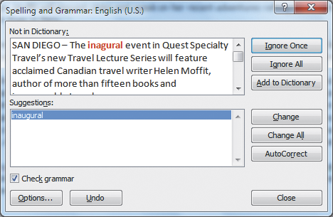
Checking Spelling and Grammar (continued)
Identified misspelled word
Suggested correction

Slide 15
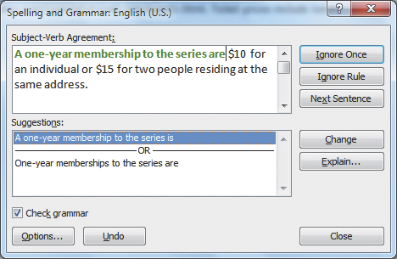
Checking Spelling and Grammar (continued)
Identified grammar error
Suggested corrections

Slide 16
Learning Activity
Complete learning activity on Word Unit B page 34.

Slide 17
Summary
Reorganize text using the Cut, Copy, and Paste commands
Use the system Clipboard and the Office Clipboard
Check a document for possible errors using the Spelling and Grammar checker
Always proofread a document

