Slide 1
Microsoft Word 2010 - Illustrated
Unit C:
Formatting Text and Paragraphs
Notes:
Formatting can enhance the appearance of a document, create visual impact, and help illustrate a document’s structure. The formatting of a document can also set a tone, allowing readers to know at a glance if the document is business-like, informal, or fun. In this unit you learn how to format text using fonts and a variety of paragraph-formatting effects such as borders, shading, and bullets.

Slide 2
Objectives
Format with fonts
Copy formats using the Format Painter
Change line and paragraph spacing
Align paragraphs
Work with tabs
2

Slide 3
Objectives (continued)
Work with indents
Add bullets and numbering
Add borders and shading
Insert clip art
3

Slide 4
Formatting with Fonts
Formatting text with fonts is a powerful way to alter the appearance of a document
A font is a complete set of characters with the same typeface or design
Arial, Times New Roman, Tahoma, and Calibri are examples of fonts
Each font has a specific design and feel
4
Notes:
Formatting text with fonts is a quick and powerful way to enhance the appearance of a document. A font is a complete set of characters with the same typeface or design. Arial, Times New Roman, Courier, Tahoma and Calibri are some of the more common fonts, but there are hundreds of others, each with a specific design and feel.

Slide 5
Formatting with Fonts (continued)
Serif fonts have a small stroke, called a serif, on the ends of characters, and are often used for body text:
Times New Roman
Garamond
Book Antiqua
Californian FB
Sans serif fonts do not have a serif, and are often used for headings:
Arial Rounded MT Bold
Comic Sans MS
Franklin Gothic Demi
Papyrus
5
Notes:
There are two types of fonts: serif fonts have a small stroke, called a serif, at the ends of the characters; sans serif fonts do not have a serif. Garamond is a serif font. Franklin Gothic Demi is a sans serif font.
The different fonts are used for different purposes. Serif fonts are commonly used for body text and sans serif fonts are commonly used for headings in business documents.
The type of font used also varies with documents that will be printed out in a hard copy or those that will be published or used solely on the computer such as a web page or a PowerPoint presentation. The Serif fonts are easier to read in a printed document while the San Serif fonts are easier to view on the computer screen or a presentation screen.
Remind students not to overuse fonts in a document; too many fonts can make a document look cluttered and be confusing. Usually it’s best to use no more than two or three fonts in a document. Formatting should make a document easier, not more difficult, to read.

Slide 6
Formatting with Fonts (continued)
Changing the size of text, or the font size, is another way to determine the impact of text
Font size is measured in points
A point is 1/72 of an inch
11-point Calibri is the default font size and font for a new Word document
You can also change the font color
6
Notes:
Reinforce the importance of choosing fonts that complement the purpose of a document. Also remind students not to overuse fonts in a document; too many fonts can make a document look cluttered and be confusing. Usually it’s best to use no more than two or three fonts in a document. Formatting should make a document easier, not more difficult, to read.
Explain that the size of a font is measured in points. Each point is 1/72 of an inch. A normal font size is 12 pt since it is easy to read for most people. However, you can choose to format text with a larger font size when you want to emphasize the text.

Slide 7
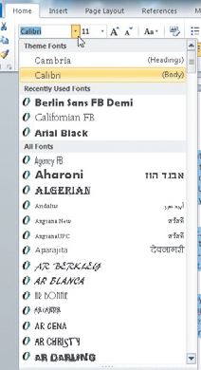
Formatting with Fonts (continued)
Change fonts using the Font list arrow
Change font size using the Font Size list arrow
Change font color using the Font Color list arrow
Font list arrow
Font Size
list arrow
Font names are formatted in the font
7
Notes:
The Font Style & Size can be changed by accessing the Font group located in the Home Tab. The fonts in this list are formatted to look like the font style on each name.

Slide 8
Learning Activity
Complete Formatting With Fonts on Page Word Unit C page 50.
Open WD C-1.docx.
Save it as WDC-Last Minute Deals

Slide 9
Copying Formats Using the Format Painter (continued)
The Format Painter allows you to copy the format setting applied to selected text to other text
Use to copy format settings to single or multiple items
Click the Format Painter button once to apply the format settings to one item
Double-click the Format Painter button to activate the Format Painter and apply settings to multiple items
9
Notes:
Ask the students to use the format painter to format

Slide 10
Learning Activity
Complete Format Painter Activity on Page Word Unit C page 52.
Complete the changes on the WDC-Last Minute Deals document
Complete # 1, 2, 3, 6, 7, 8, 9, 10

Slide 11
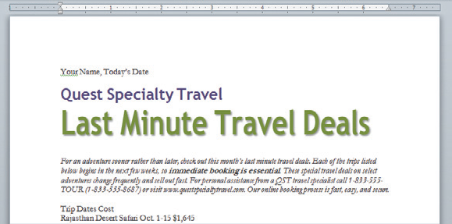
Copying Formats Using the Format Painter (continued)
48 point, green, shadow effect, 80% character scale
Italic
Bold
11

Slide 12
Changing Line and Paragraph Spacing
Adding white space to a document can make it easier to read
Increase space between lines using the Line and Paragraph Spacing list arrow
Increase space between paragraphs using the Before and After text boxes in the Paragraph group on the Page Layout tab
12
Notes:
Increasing the amount of space between lines adds more white space to a document and can make it easier to read. Adding space before and after paragraphs can also open up a document and improve its appearance. You use the line and paragraph spacing list arrow in the paragraph group on the home tab to quickly change line spacing. To change paragraph spacing you use the Spacing options in the Paragraph group on the page layout tab. Line and paragraph spacing are measured in points.

Slide 13
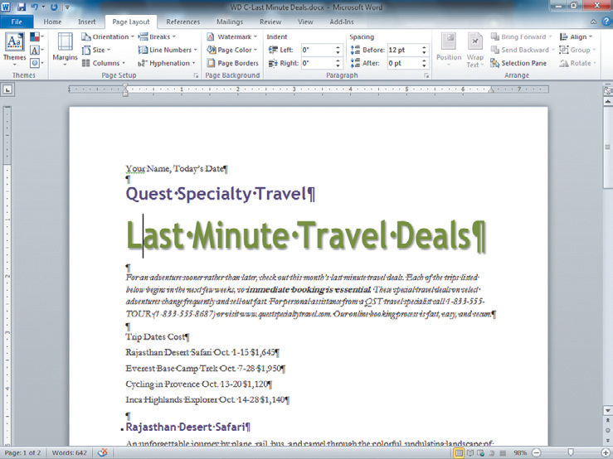
Changing Line and Paragraph Spacing (continued)
Spacing section shows paragraph spacing for paragraph where insertion point is located
12 points of space added before title paragraph
Line spacing is 1.15
Line spacing is 1.5
6 points of space added after heading paragraph
13

Slide 14
Learning Activity
Complete Changing Line and Paragraph Spacing Activity on Page Word Unit C page 54.
Complete the changes on the WDC-Last Minute Deals document
Complete # 1, 2, 3

Slide 15
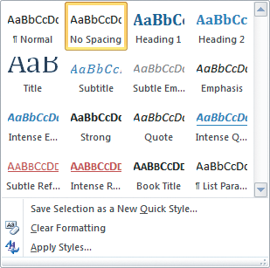
Changing Line and Paragraph Spacing (continued)
Each Quick Style set includes styles for a title, several heading levels, body text, quotes, and lists
Each Quick Style Set has a different design
Notes:
When starting a blank document in Microsoft Word such as a letter, click on the “No Spacing” Quick Style. This will eliminate the unneeded double spacing that will drive you crazy!!!!

Slide 16
Aligning Paragraphs
Paragraphs are aligned relative to the left and right margins
Left-aligned text is flush with the left margin and has a ragged right edge
Text is left-aligned by default
Right-aligned text is flush with the right margin
Centered text is positioned evenly between the margins
Justified text is flush with both the left and right margins
16
Notes:
Changing paragraph alignemtn is another way to enhance a document’s appearance. Paragraphs are aligned relative to the left and right margins in a document. By default, text is left-aligned, which means it is flush with the left margins and has a ragged right edge. Using the alignment buttons in the paragraph group, you can right align a paragraph – make it flush with the right margin – or center a paragraph so hat it is positioned evenly between the left and right margins. You can also jsutify a paragraph so that both the left and right edges of the paragraph are flush with both the left and right margins. An example of this would be in a newspaper or magazine article.

Slide 17
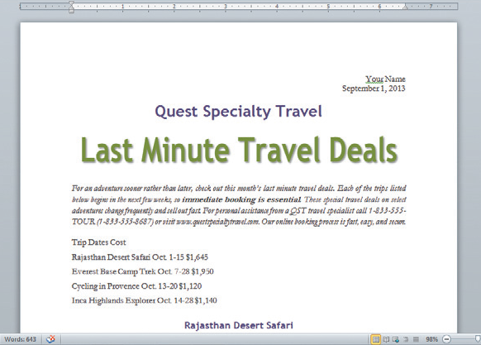
Aligning Paragraphs (continued)
Change paragraph alignment using the alignment buttons in the Paragraph group on the Home tab
Right-aligned
Centered
Justified
Left-aligned
17

Slide 18
View Ruler Button
Click on the View Ruler button at the top of the vertical scroll bar to display the rulers if they are not already showing.

Slide 19
Learning Activity
Complete Aligning Paragraph Activity on Page Word Unit C page 56.
Complete the changes on the WDC-Last Minute Deals document
Complete # 1, 2, 3, 4, 5, 6, 7, 8

Slide 20
Adding Borders and Shading
Adding borders and shading to text can help to enhance the information in a document
A border is a line added above, below, to the side of, or around words or paragraphs
Shading is a color or pattern that is added behind words or paragraphs
Use the Borders button or the Shading button in the Paragraph group on the Home tab
20
Notes:
Borders and shading can add color and splash to a document. Borders are lines you add above, below, to the side or around words or paragraphs. You can format borders using different lines styles, colors, and widths.
Shading is a color or pattern you apply behind words or paragraphs to make them stand out on a page. You apply borders and shading using the Borders button and the Shading button in the paragraph group on the Home Tab.

Slide 21
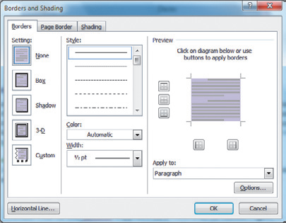
Adding Borders and Shading (continued)
Border options
Box
Shadow
3-D
Custom
Line style
Line color
Line width
21

Slide 22
Adding Borders and Shading (continued)
Shading options
Fill color
Theme color
Standard color
Custom color
Pattern style
Tint (e.g. 75%)
Pattern (e.g. diagonal lines)
22

Slide 23
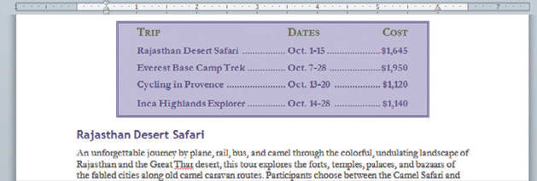
Adding Borders and Shading (continued)
Shading
Border
23

Slide 24
Learning Activity
Complete Adding Borders and Shading Activity on Page Word Unit C page 64.
Complete the changes on the WDC-Last Minute Deals document
Complete # 1, 2, 3, 4, 5 & 6

Slide 25
Adding Borders and Shading (continued)
Highlighting text in a document
Highlighting is transparent color that is applied to text using the Highlight pointer
Highlighting is most effective when a document is viewed on screen
Highlighting does print
To highlight text, click the Text Highlight Color list arrow in the Font group on the Home tab, select a color, then select the text
25
Notes:
The highlight tool allows you to mark and find important text in a document. Highlighting is transparent color that is applied to text using the Highlight pointer. To highlight text, click the Text Highlight color list arrow in the font group on the Home tab, select a color then use the I beam part of the pointer to select the text you want to highlight. Click the Highlight button to turn off the Highlight pointer. To remove the highlighting, select the highlighted text and click the Highlight color selection button, then click “No Color”. Highlighting prints, but it is used most effectively when a document is viewed on screen.

Slide 26
Inserting Clip Art
Illustrate a document with clip art
Clip art is a collection of graphic images that you can insert in a document
Clip art images are stored in the Clip Organizer
Clips are the media files, including graphics, photographs, sounds, movies, and animations, that come with Word
Add clips by clicking the Clip Art button in the Illustrations group on the Insert tab
26
Notes:
Clip art is a collection of graphic images that you can insert into a document. Clip art images are stored in the Clip organizer, which is a library of the clips – It can contain medial files such as graphics, photographs, sounds, movies and animations that come with Word. You can add a clip to a document using the Clip Art command on the insert tab.

Slide 27
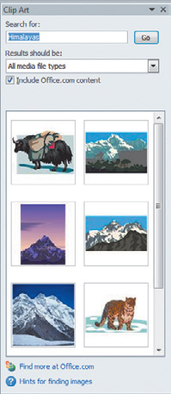
Inserting Clip Art (continued)
Search for clips using the ClipArt task pane
Search using a keyword
Choose type of clips to search
Results of a clip search
27

Slide 28
Inserting Clip Art (continued)
A clip is inserted as an inline graphic at the location of the insertion point
An inline graphic is a graphic that is part of the line of text
A floating graphic is independent from text and can be moved anywhere on a page
Drag the sizing handles to reduce or enlarge the size of a graphic
28

Slide 29
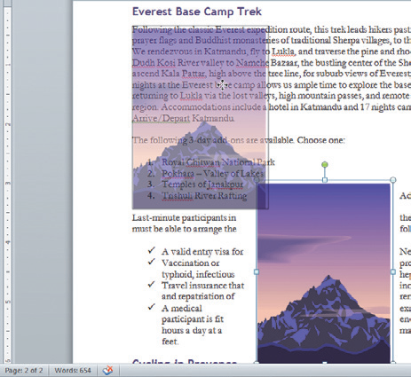
Inserting Clip Art (continued)
Wrap text around the graphic
Apply a text wrapping style
Click the Wrap Text button in the Arrange group on the Picture Tools Format tab
Faded image shows graphic being dragged
Sizing handle
Floating graphic
29

Slide 30
Learning Activity
Insert a clipart image into your WDC Last Minute Deals Document.
Type in Himalayas
Complete # 1, 2, 3, 4, 5

Slide 31
Setting Document Margins
Document margins are the blank areas between the edge of the text and the edge of the page
Default margins are 1” at the top, bottom, left, and right sides of the page
Changing a document’s margins changes the amount of text that fits on a page
31
Notes:
Changing a document’s margins is one way to change the appearance of a document and control the amount of text that fits on a page. The margins of a document are the blank areas between the edge of the text and edge of the page. When you create a document in Word, the default margins are 1” at the top, bottom, left, and right sides of the page.

Slide 32
Setting Document Margins (continued)
To adjust a document’s margins:
Click the Margins button in the Page Setup group on the Page Layout tab, then click Custom Margins
Change margin settings on the Margins tab in the Page Setup dialog box
Drag a margin indicator on a ruler to a new location
32
Notes:
You can adjust the size of a document’s margins using the Margins command on the Page Layout tab or using the rulers.

Slide 33
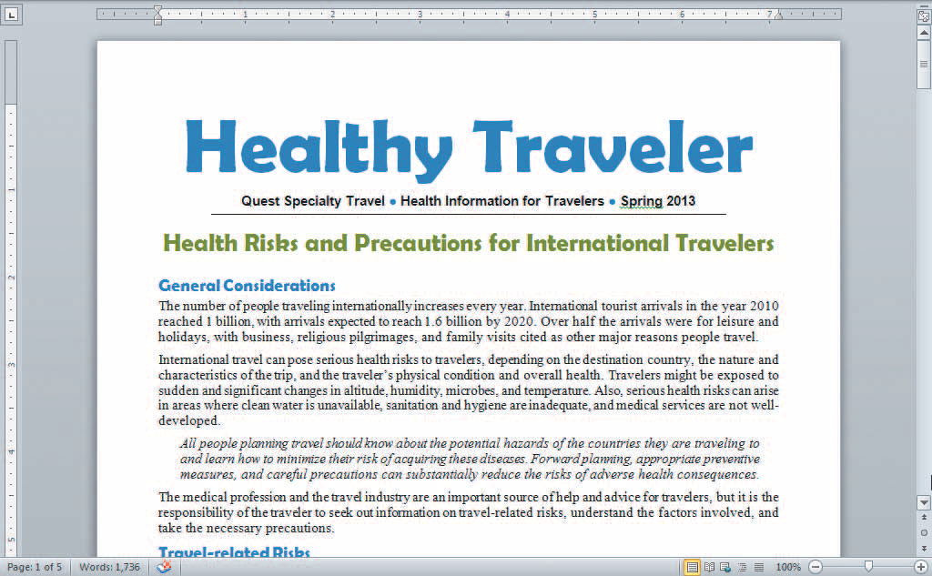
Setting Document Margins (continued)
Top margin
Right margin
Ruler shows location of left margin
Ruler shows location of top margin
Left margin
33

Slide 34
Setting Document Margins (continued)
Page orientation
Portrait orientation means a page is taller than it is wide
The default page orientation for a document is portrait
Landscape orientation means a page is wider than it is tall
Paper size
Default paper size is 8.5” x 11”
34

Slide 35
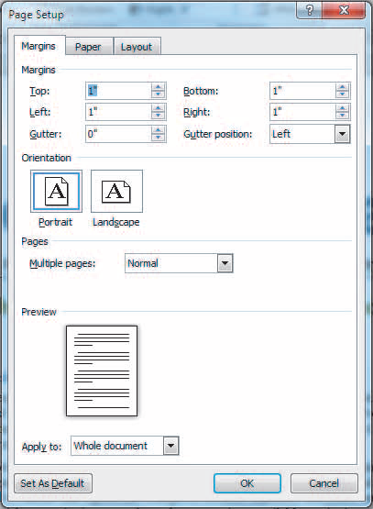
Setting Document Margins (continued)
The Page Setup dialog box
Margins tab
Change margins, page orientation, and format the layout of pages in a multiple page document
Paper tab
Change paper size and paper source
Layout tab
Format sections, format headers and footers, and change vertical alignment
35

